Slide 1
Static Sites

Slide 2
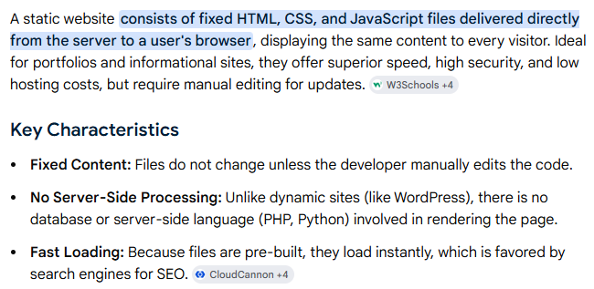

Slide 3
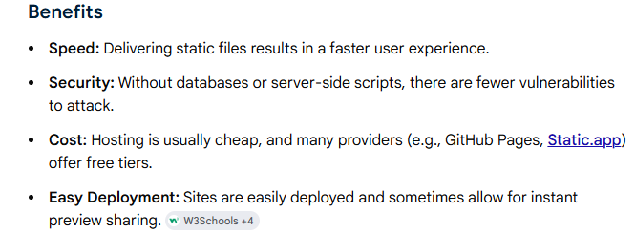

Slide 4
Steps:
Prepare html project
Make sure your project folder contains:
Index.html (entry point !! IMPORTANT)
push github repository

Slide 5
